Slide 1



ML/DL for Everyone with
Lecture 5: Linear regression
in PyTorch way
Sung Kim <hunkim+ml@gmail.com> HKUST
Code: https://github.com/hunkim/PyTorchZeroToAll
Slides: http://bit.ly/PyTorchZeroAll
Videos: http://bit.ly/PyTorchVideo

Slide 2

Call for Comments
Please feel free to add comments directly on these slides.
Other slides: http://bit.ly/PyTorchZeroAll
Picture from http://www.tssablog.org/archives/3280

Slide 3
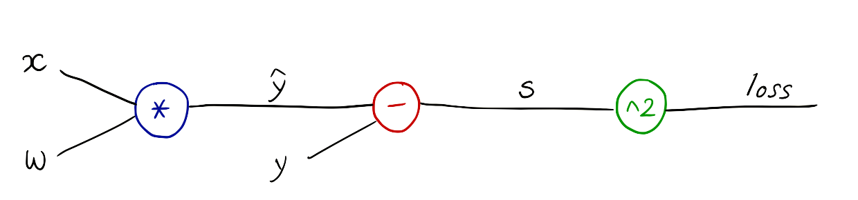
PyTorch forward/backward
w = Variable(torch.Tensor([1.0]), requires_grad=True) # Any random value
# our model forward pass
def forward(x):
return x * w
# Loss function
def loss(x, y):
y_pred = forward(x)
return (y_pred - y) * (y_pred - y)
# Training loop
for epoch in range(10):
for x_val, y_val in zip(x_data, y_data):
l = loss(x_val, y_val)
l.backward()
print("\tgrad: ", x_val, y_val, w.grad.data[0])
w.data = w.data - 0.01 * w.grad.data
# Manually zero the gradients after updating weights
w.grad.data.zero_()
print("progress:", epoch, l.data[0])
Notes:
loss = (\hat{y}-y)^2 = (x*w-y)^2
\frac{\partial{loss}}{\partial{w}}=?

Slide 4



PyTorch Rhythm
Design your model using class with Variables
Construct loss and optimizer
(select from PyTorch API)
Training cycle
(forward, backward, update)

Slide 5

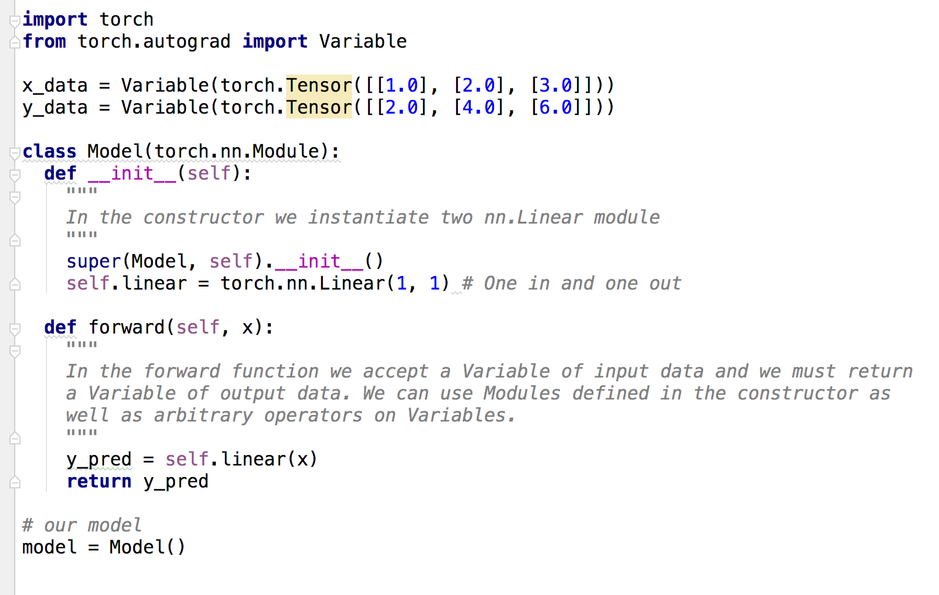
Data definition (3x1)

Slide 6
Model class in PyTorch way

Slide 7
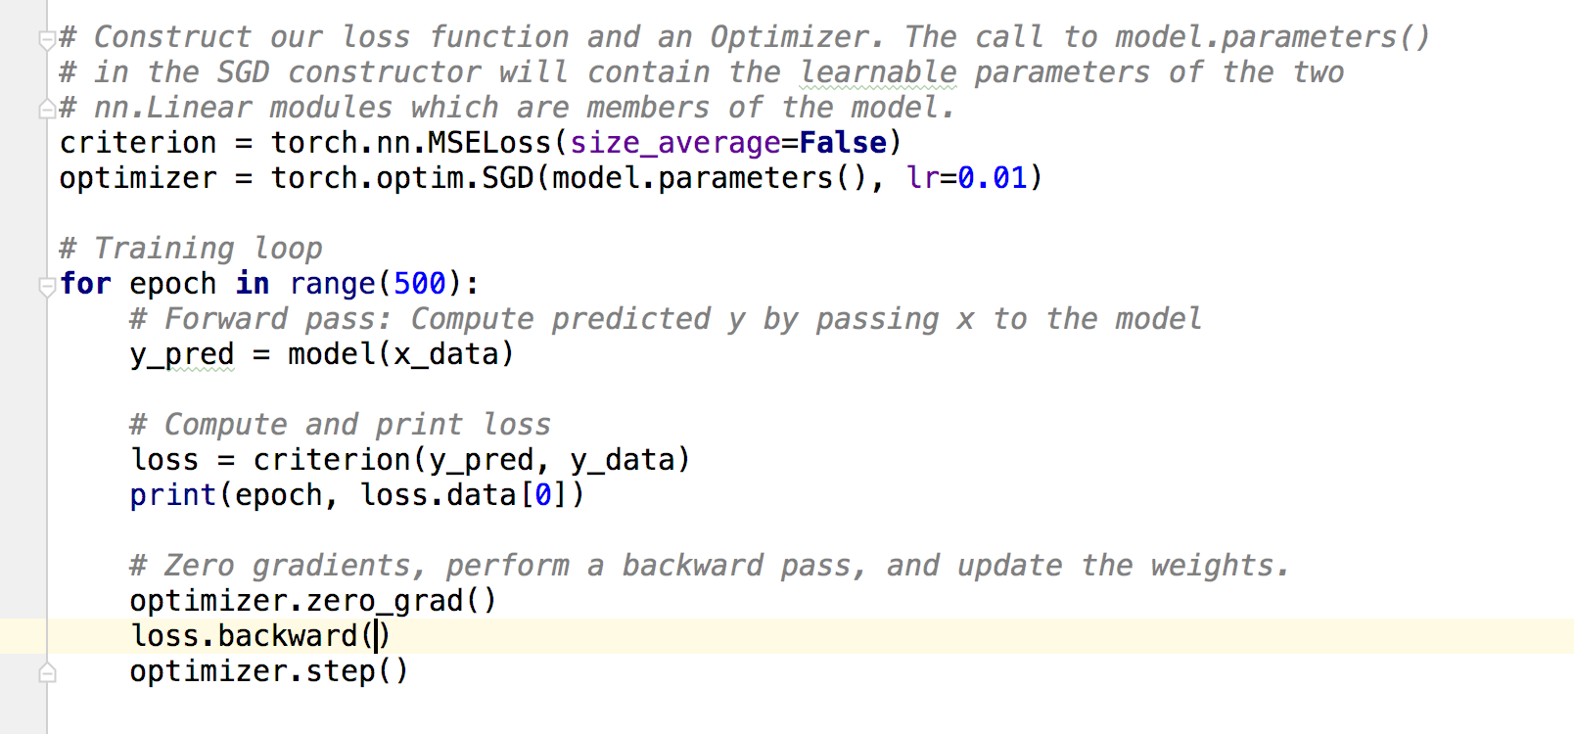
Construct loss and optimizer
https://github.com/jcjohnson/pytorch-examples

Slide 8
Training: forward, loss, backward, step
https://github.com/jcjohnson/pytorch-examples

Slide 9
Training: forward, loss, backward, step
for x_val, y_val in zip(x_data, y_data):
...
w.data = w.data - 0.01 * w.grad.data
https://github.com/jcjohnson/pytorch-examples

Slide 10
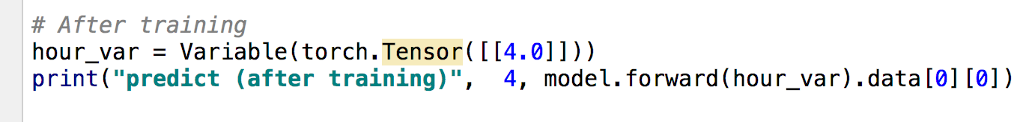
Testing Model
https://github.com/jcjohnson/pytorch-examples

Slide 11
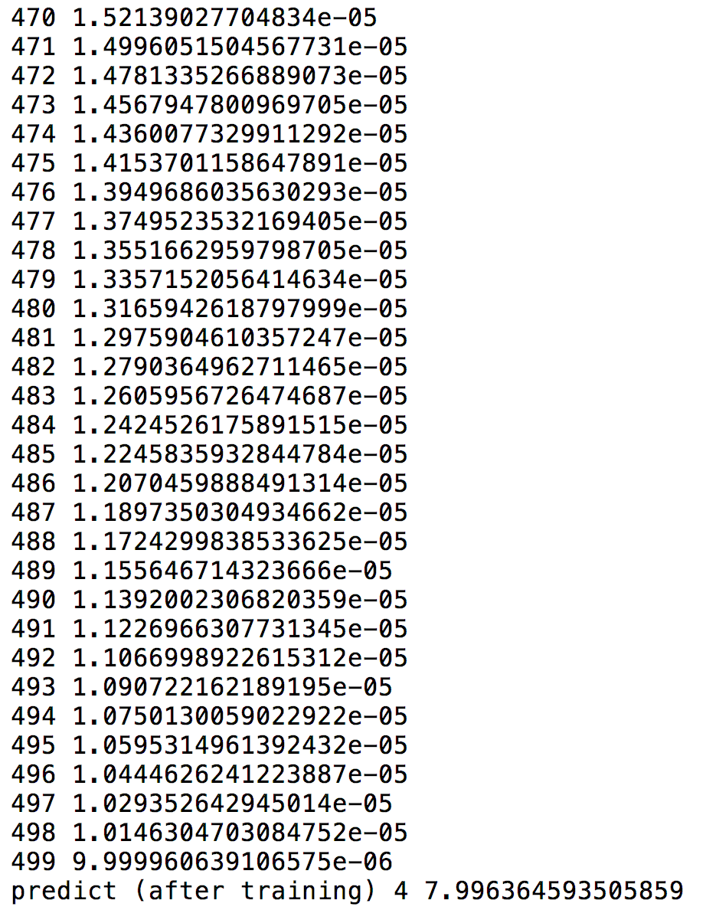
Output
https://github.com/jcjohnson/pytorch-examples

Slide 12
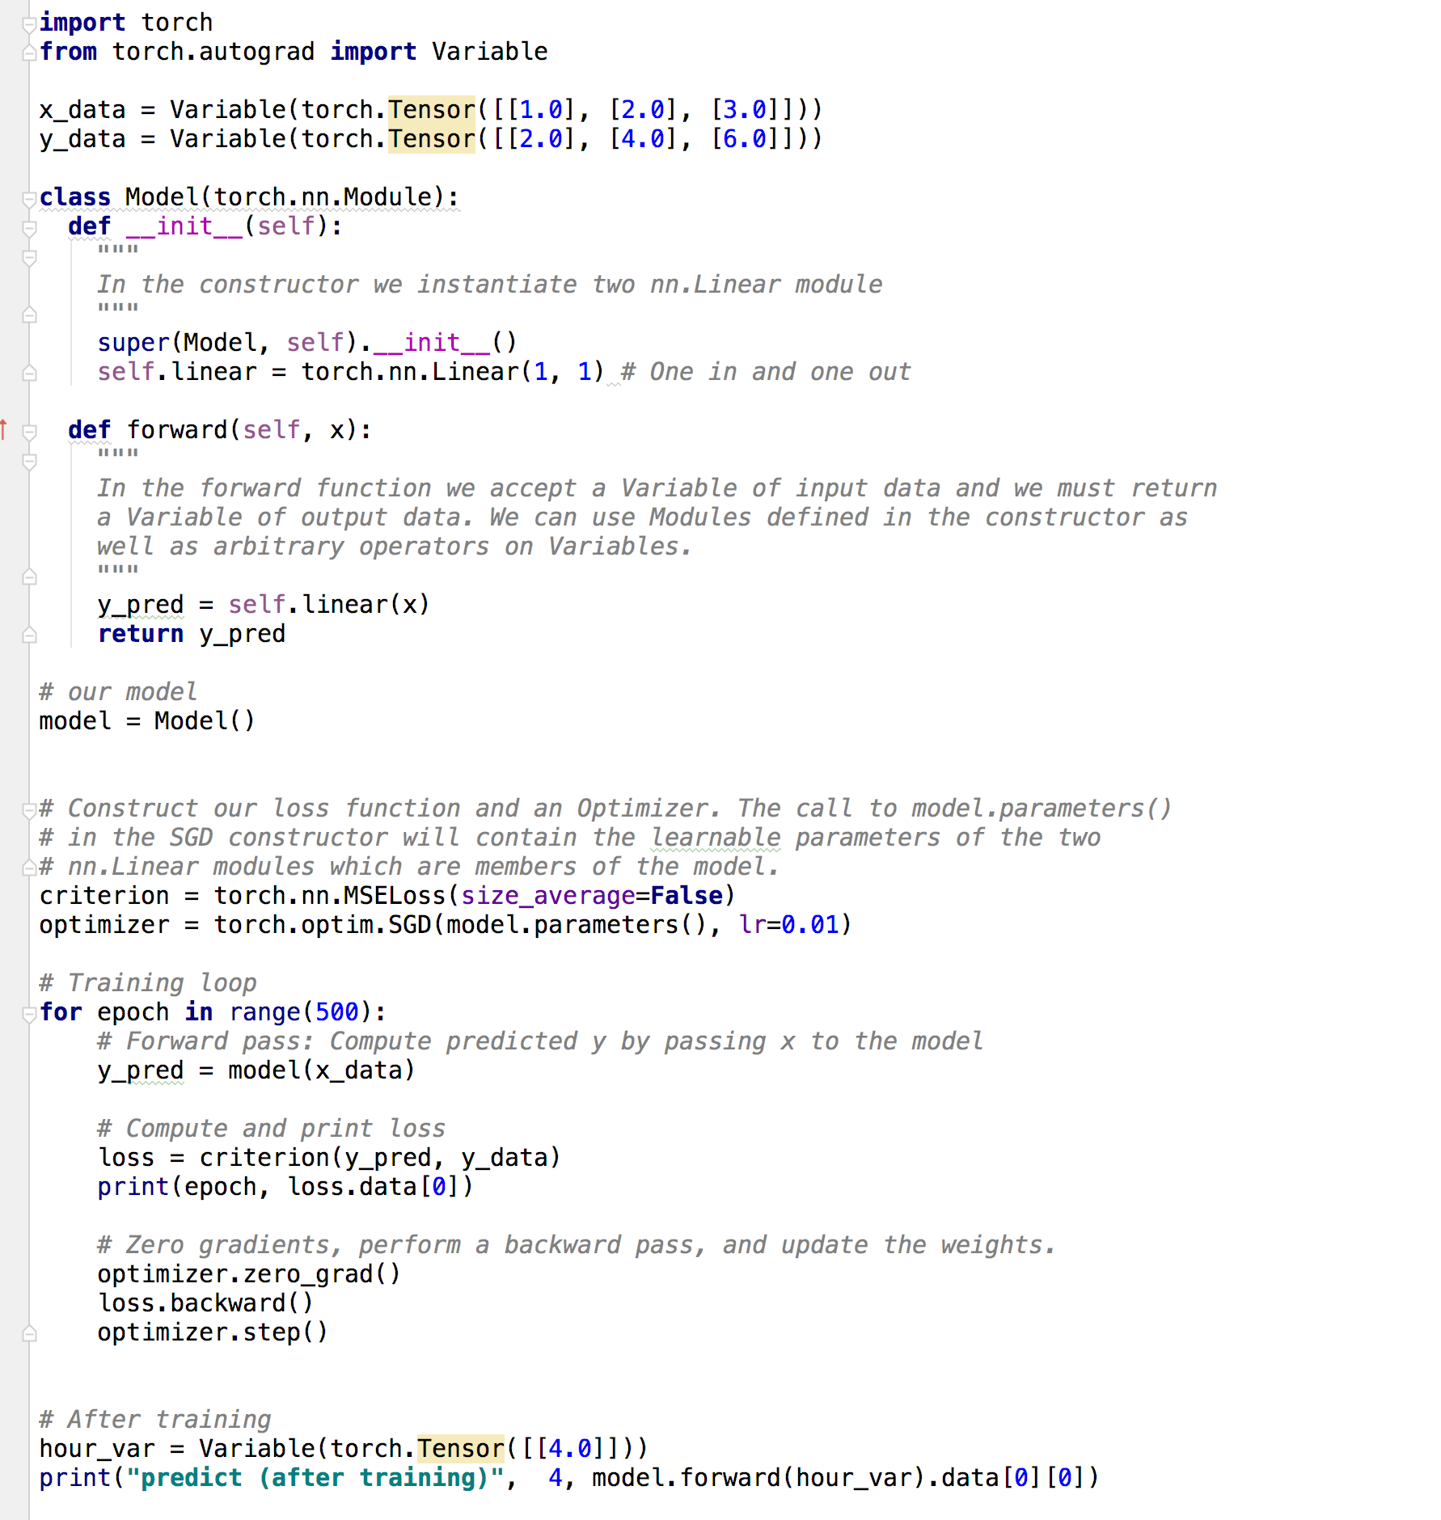

Slide 13
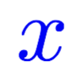
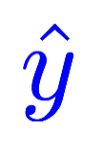
Design your model using class
Linear
Construct loss and optimizer
(select from PyTorch API)
Training cycle
(forward, backward, update)

Slide 14
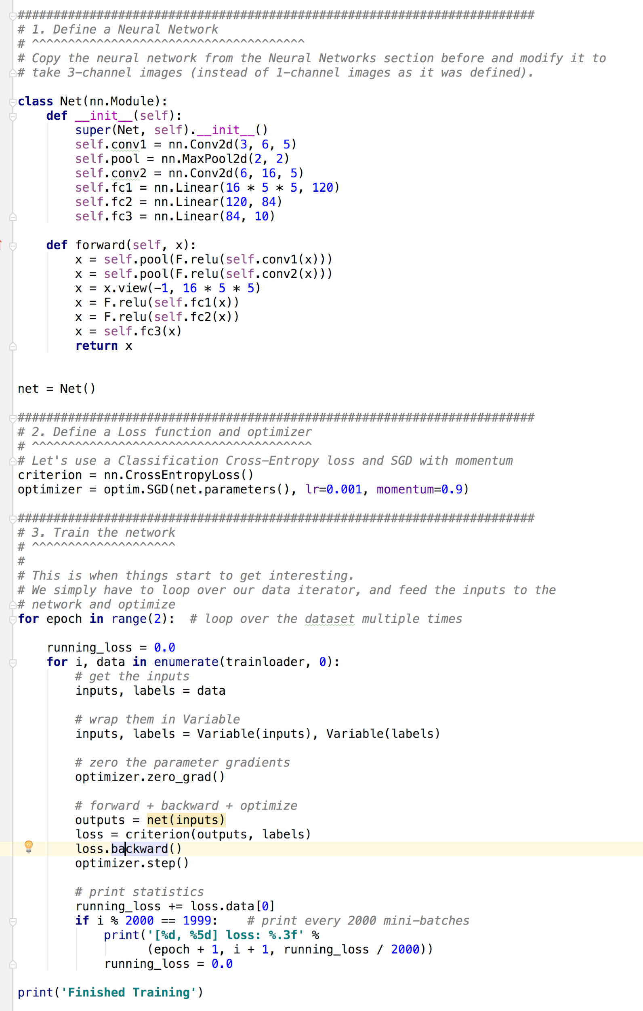
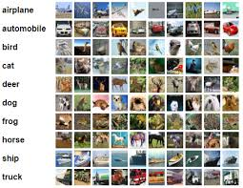
Training CIFAR10 Classifier
http://pytorch.org/tutorials/beginner/blitz/cifar10_tutorial.html

Slide 15
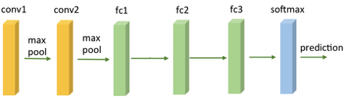
Training CIFAR10 Classifier
Design your model using class
Construct loss and optimizer
(select from PyTorch API)
Training cycle
(forward, backward, update)
http://pytorch.org/tutorials/beginner/blitz/cifar10_tutorial.html

Slide 16
Exercise 5-1: Try other optimizers
torch.optim.Adagrad
torch.optim.Adam
torch.optim.Adamax
torch.optim.ASGD
torch.optim.LBFGS
torch.optim.RMSprop
torch.optim.Rprop
torch.optim.SGD
http://pytorch.org/docs/master/optim.html#algorithms

Slide 17
Exercise 5-2: Read more PyTorch examples
http://pytorch.org/tutorials/beginner/pytorch_with_examples.html

Slide 18


Lecture 6:
Logistic regression

